Slide 1

Introduction to Cassandra DB
STW220CT: Data and Information Retrieval
Prepared By : Kiran Rana

Slide 2




Taxonomy of NoSQL
Key-value
Graph DB
Document-Oriented
Column family

Slide 3
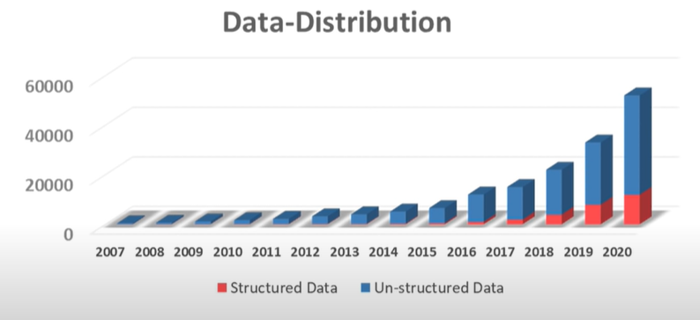
Structure of Data Today

Slide 4
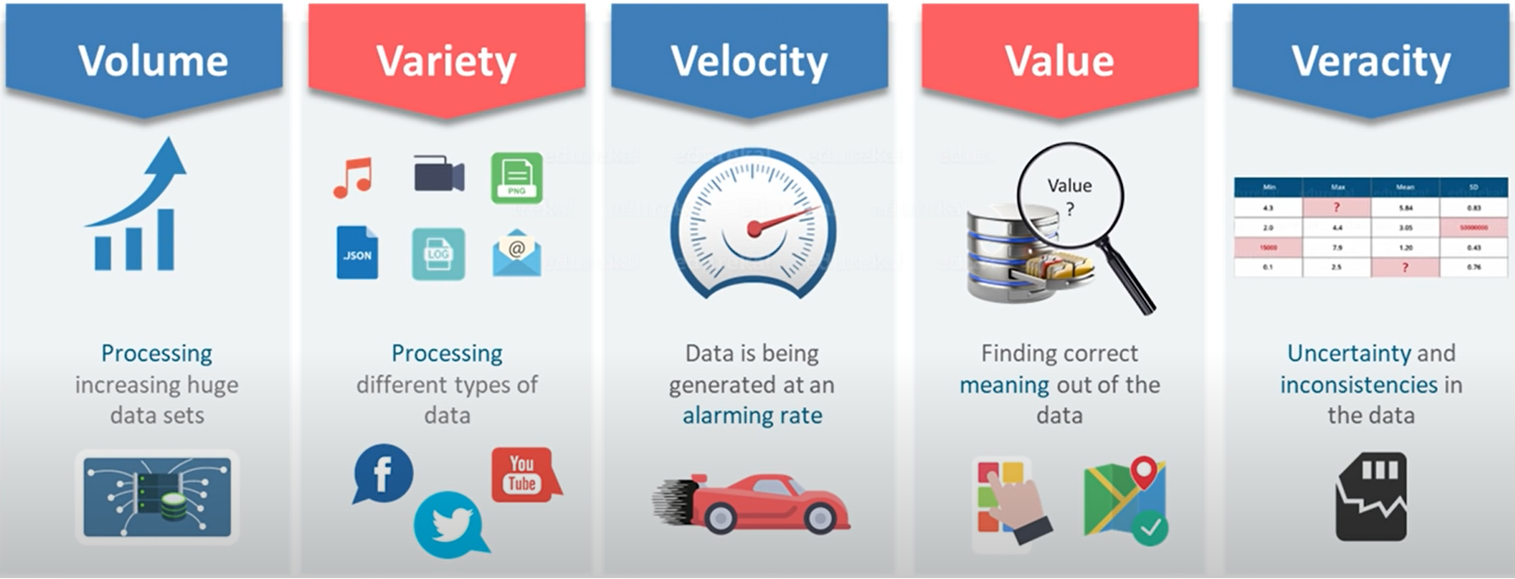
5 V’s of Big Data

Slide 5
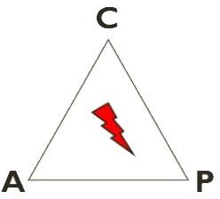
CAP Theorem
Consistency
All replica contains the same version of data.
Availability
System remains operational on failing nodes.
Partition-Tolerance
Multiple entry point
System remains operational on system split
CAP Theorem :
Satisfying all three at the same time is impossible
Notes:
In theoretical computer science, the CAP theorem, also named Brewer's theorem after computer scientist Eric Brewer, states that it is impossible for a distributed data store to simultaneously provide more than two out of the following three guarantees:

Slide 6
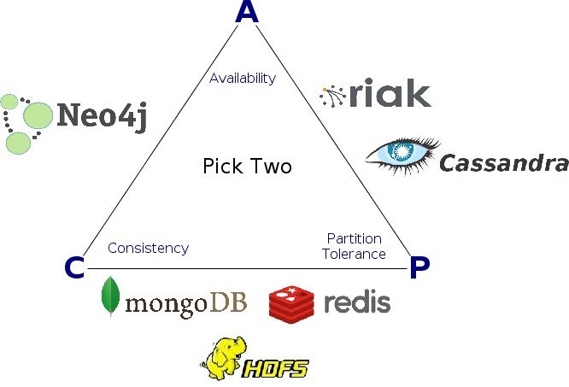

CAP Theorem

Slide 7
Google Big Table
Google invented BigTable to store the massive amount of semi-structured data it was generating.
Basic model store items indexed by (rowkey,columnkey) pair plus a time stamp.
Item with the same rowkey referes to the same thing – like row in a normal table.
Column key can vary from row to row.

Slide 8
Facebook
Facebook took Google’s BigTable and Amazon Dynamo(another KV store) and created a database then that was then put to Apache as Cassandra.
Similarly , HBase , which is the database used in Hadoop is also based on Google BigTable

Slide 9
Column Family Databases
In a Column-Family database, rows are indexed by an ID.
Columns are flexible and can vary from row to row.
Columns are organized into families of related columns , a bit like relational database are organized into tables.

Slide 10
Row vs Column oriented database
There are two ways to organize relational databases:
Row oriented
Column oriented (also known as columnar or C-store)

Slide 11
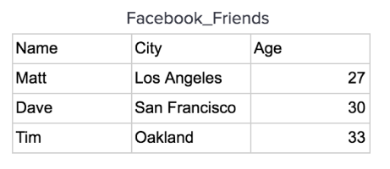
1. Row- Oriented Databases
Traditional Database Management Systems were created to store data. They are optimized to read and write a single row of data which lead to a series of design choices including having a row store architecture.
In a row store, or row-oriented database, the data is stored row by row, such that the first column of a row will be next to the last column of the previous row.
For instance, let’s take this Facebook Friends data:

Slide 12
Row-oriented Databases
This data would be stored on a disk in a row-oriented database in order row by row like this:
This allows the database write a row quickly because, all that needs to be done to write to it is to tack on another row to the end of the data.

Slide 13

Writing to Row Store Databases
Let’s use the data stored in a database:
If we want to add a new record:
We can just append it to the end of the current data:

Slide 14
Reading from Row Store Databases
Row oriented databases are fast at retrieving a row or a set of rows but when performing an aggregation it brings extra data (columns) into memory which is slower than only selecting the columns that you are performing the aggregation on.
In addition the number of disks the row-oriented database might need to access is usually larger.
Extra data into Memory
Say we want to get the sum of ages from the Facebook Friends data. To do this we will need to load all nine of these pieces of data into memory to then pull out the relevant data to do the aggregation.
This is wasted computing time.

Slide 15
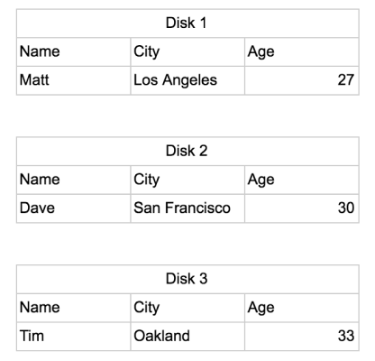
Number of Disks accessed
Let’s assume a Disk can only hold enough bytes of data for three columns to be stored on each disk. In a row-oriented database the table above would be stored as:
Notes:
To get the sum of all the people’s ages the computer would need to look through all three disks and across all three columns in each disk in order to make this query.
So we can see that while adding data to a row oriented database is quick and easy, getting data out of it can require extra memory to be used and multiple disks to be accessed.

Slide 16
2. Column-Oriented Databases
Data Warehouses were created in order to support analyzing data. These types of databases are read optimized.
In a C-Store, columnar, or Column-oriented database, the data is stored such that each row of a column will be next to other rows from that same column.
Let’s look at the same data set again and see how it would be stored in a column oriented database.

Slide 17
2. Column-oriented Database
A table is stored one column at a time in order row by row:
Writing to a Column Store Databases
We have to navigate around the data to plug each column in to where it should be.

Slide 18
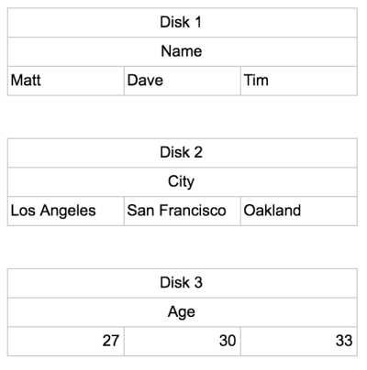
Data Stored in Disk
If the data was stored on a single disk it would have the same extra memory problem as a row-oriented database, since it would need to bring everything into memory. However, column- oriented databases will have significant benefits when stored on separate disks.
If we placed the table above into the similarly restricted three columns of data disk, they would be stored like this:

Slide 19
Reading from a Column store Database
To get the sum of the ages the computer only needs to go to one disk (Disk 3) and sum all the values inside of it. No extra memory needs to be pulled in, and it accesses a minimal number of disks.
While this is a slight over simplification, it illustrates that by organizing data by column the number of disks that will need to be visited will be reduced and the amount of extra data that has to be held in memory is minimized. This greatly increases the overall speed of the computation.
There are other ways in which a column-oriented database can get more performance.

Slide 20
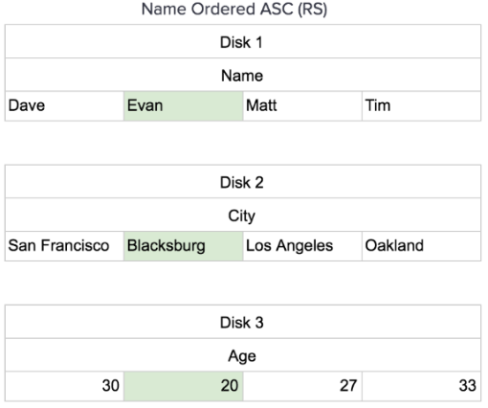
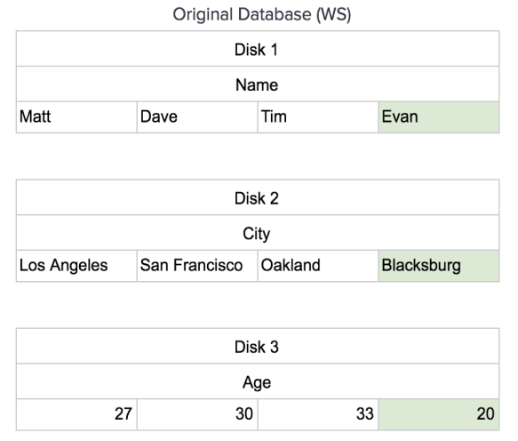
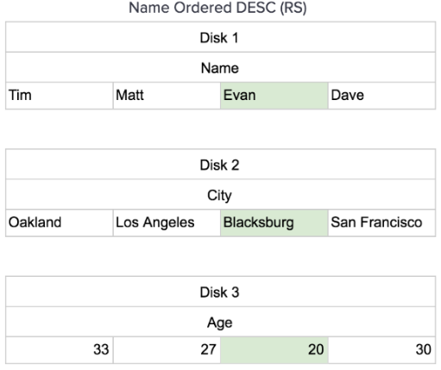
Ordering the data

Slide 21
What is Cassandra?
The Apache Cassandra database is the right choice when you need scalability and high availability without compromising performance. Linear Scalability and proven fault-tolerance on commodity hardware or cloud infrastructure make it the perfect platform for mission-critical data.
Cassandra's support for replicating across multiple data-centers is best-in-class, providing lower latency for your users and the peace of mind of knowing that you can survive regional outages.

Slide 22
Who is using Cassandra??
Cassandra is in use at
Apple (75,000+ nodes),
Spotify (3,000+ nodes),
eBay,
GitHub
Instagram
Netflix
Reddit
Weather Channel
Capital One, Macy's, Bank of America, Netflix, Twitter, Urban Airship, Constant Contact, Reddit, Cisco, OpenX, Rackspace, Ooyala, and more companies that have large active data sets.
The largest known Cassandra cluster has more than 300 TB of data across more than 400 machines

Slide 23
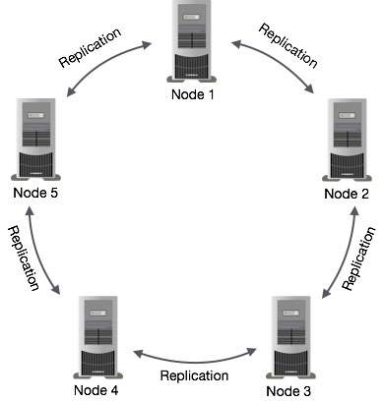
Basic Architecture of Cassandra

Slide 24
Components of Cassandra
Node − It is the place where data is stored.
Data center − It is a collection of related nodes.
Cluster − A cluster is a component that contains one or more data centers.
Commit log − The commit log is a crash-recovery mechanism in Cassandra. Every write operation is written to the commit log.
Mem-table − A mem-table is a memory-resident data structure. After commit log, the data will be written to the mem-table. Sometimes, for a single-column family, there will be multiple mem-tables.
SSTable − It is a disk file to which the data is flushed from the mem-table when its contents reach a threshold value.
Bloom filter − These are nothing but quick, nondeterministic, algorithms for testing whether an element is a member of a set. It is a special kind of cache. Bloom filters are accessed after every query.

Slide 25

Node
Server
Where you store data.

Slide 26
Token
Server
Each partition is a 64-bit value
Consistent hash between -2⁶³
to +2⁶³⁻¹
Each node owns a range of
those values.
The token is the beginning of that range to the
next node’s token value.
Virtual nodes break these down further
Notes:
A token is the hashed value of the primary key. When you add nodes to Cassandra you assign a token range to each node, or let Cassandra do that for you. Then when you add data to Cassandra it calculates the token and uses that to figure out on which server (node) to store the new data.
Datacenter : A collection of related nodes. A datacenter can be a physical datacenter or virtual datacenter. Different workloads should use separate datacenters, either physical or virtual. Replication is set by datacenter. Using separate datacenters prevents Cassandra transactions from being impacted by other workloads and keeps requests close to each other for lower latency. Depending on the replication factor, data can be written to multiple datacenters. datacenters must never span physical locations.

Slide 27
The cluster
Server
0 - 100
Token | Range
0 | 0 - 100
Notes:
A cluster contains one or more datacenters. It can span physical locations.

Slide 28
The cluster
Server
0 - 50
Token | Range
0 | 0 - 50
51 | 51 - 100
Server
51 - 100
Notes:
A cluster contains one or more datacenters. It can span physical locations.

Slide 29
The cluster
Server
0 - 25
Token | Range
0 | 0 - 25
26 | 26 - 50
51 | 51 - 75
76 | 76 - 100
Server
Server
51 - 75
26 - 50
Server
76 - 100
Notes:
A cluster contains one or more datacenters. It can span physical locations.

Slide 30
Replication
DC 1
10.0.0.1
00 - 25
10.0.0.4
76 - 100
10.0.0.2
26 - 50
DC 1 : RF = 1
Node | Primary
10.0.0.1 | 0 - 25
10.0.0.2 | 26 - 50
10.0.0.3 | 51 - 75
10.0.0.4 | 76 - 100
10.0.0.3
51 - 75

Slide 31
Replication
DC 1
76 - 100
10.0.0.1
00 - 25
10.0.0.4
76 - 100
51 - 75
10.0.0.2
26 - 50
0 - 25
DC 1 : RF = 2
Node | Primary | Replica
10.0.0.1 | 0 - 25 | 76 - 100
10.0.0.2 | 26 - 50 | 0 – 25
10.0.0.3 | 51 - 75 | 26 – 50
10.0.0.4 | 76 - 100 | 51 - 75
10.0.0.3
51 - 75
26 - 50

Slide 32
Replication
DC 1
10.0.0.1
00 – 25
76 – 100
51 - 75
10.0.0.4
76 - 100
51 – 75
26 - 50
10.0.0.2
26 - 50
0 – 25
76 - 100
DC 1 : RF = 3
Node | Primary | Replica | Replica
10.0.0.1 | 0 - 25 | 76 - 100 | 51 - 75
10.0.0.2 | 26 - 50 | 0 – 25 | 76 - 100
10.0.0.3 | 51 - 75 | 26 – 50 | 0 - 25
10.0.0.4 | 76 - 100 | 51 - 75 | 26 - 50
10.0.0.3
51 - 75
26 – 50
0 - 25

Slide 33
Consistency
DC 1
10.0.0.1
00 – 25
76 – 100
51 - 75
Client
Write to partition 15
10.0.0.4
76 - 100
51 – 75
26 - 50
10.0.0.2
26 - 50
0 – 25
76 - 100
DC 1 : RF = 3
Node | Primary | Replica | Replica
10.0.0.1 | 0 - 25 | 76 - 100 | 51 - 75
10.0.0.2 | 26 - 50 | 0 – 25 | 76 - 100
10.0.0.3 | 51 - 75 | 26 – 50 | 0 - 25
10.0.0.4 | 76 - 100 | 51 - 75 | 26 - 50
10.0.0.3
51 - 75
26 – 50
0 - 25
Notes:
Any node can act as coodinator

Slide 34
Consistency level
Consistency Level | Number of Nodes Acknowledge
One | One replica acknowledges read One replica commits write
Quorum | 51% replica nodes agree on read or commit write
Local Quorum | 51% on DC
Notes:
One means : it will not wait for other nodes for the acknowledgments
Quorum = (RF + 1)/2

Slide 35
Consistency
DC 1
10.0.0.1
00 – 25
76 – 100
51 - 75
Client
Write to partition 15
CL = One
10.0.0.4
76 - 100
51 – 75
26 - 50
10.0.0.2
26 - 50
0 – 25
76 - 100
DC 1 : RF = 3
Node | Primary | Replica | Replica
10.0.0.1 | 0 - 25 | 76 - 100 | 51 - 75
10.0.0.2 | 26 - 50 | 0 – 25 | 76 - 100
10.0.0.3 | 51 - 75 | 26 – 50 | 0 - 25
10.0.0.4 | 76 - 100 | 51 - 75 | 26 - 50
10.0.0.3
51 - 75
26 – 50
0 - 25
Notes:
Any node can act as coodinator

Slide 36

Consistency
DC 1
Scenario :
When two nodes goes
down
10.0.0.1
00 – 25
76 – 100
51 - 75
Client
Write to partition 15
CL = One
10.0.0.4
76 - 100
51 – 75
26 - 50
10.0.0.2
26 - 50
0 – 25
76 - 100
DC 1 : RF = 3
Node | Primary | Replica | Replica
10.0.0.1 | 0 - 25 | 76 - 100 | 51 - 75
10.0.0.2 | 26 - 50 | 0 – 25 | 76 - 100
10.0.0.3 | 51 - 75 | 26 – 50 | 0 - 25
10.0.0.4 | 76 - 100 | 51 - 75 | 26 - 50
10.0.0.3
51 - 75
26 – 50
0 - 25
Notes:
Any node can act as coodinator

Slide 37
Consistency
DC 1
Scenario :
When one nodes goes
down
10.0.0.1
00 – 25
76 – 100
51 - 75
Client
Write to partition 15
CL = Quorum
10.0.0.4
76 - 100
51 – 75
26 - 50
10.0.0.2
26 - 50
0 – 25
76 - 100
DC 1 : RF = 3
Node | Primary | Replica | Replica
10.0.0.1 | 0 - 25 | 76 - 100 | 51 - 75
10.0.0.2 | 26 - 50 | 0 – 25 | 76 - 100
10.0.0.3 | 51 - 75 | 26 – 50 | 0 - 25
10.0.0.4 | 76 - 100 | 51 - 75 | 26 - 50
10.0.0.3
51 - 75
26 – 50
0 - 25
Notes:
Any node can act as coodinator

Slide 38
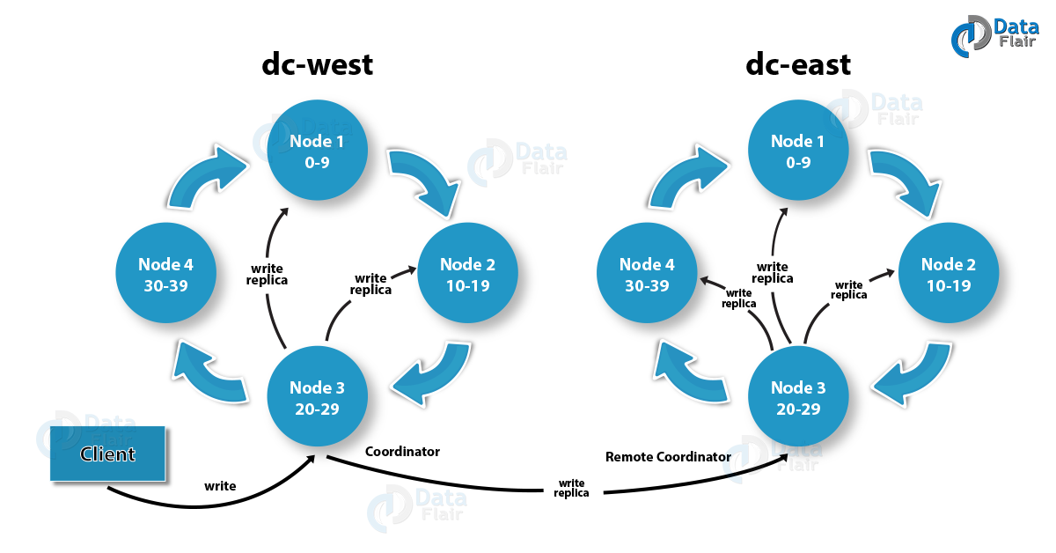
Multi-datacenter

Slide 39
Multi-datacenter
Scenario :
When one Data center goes
down

Slide 40
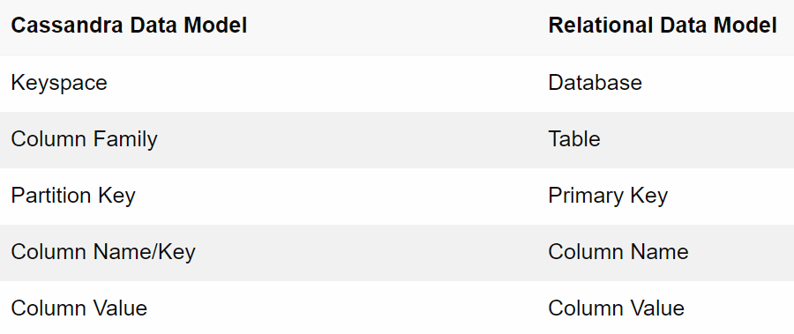
Cassandra Data model

Slide 41
When to use Cassandra ?
Writes exceed reads by a large margin.
Data is rarely updated and when updates are made they are idempotent.
Read Access is by a known primary key.
Data can be partitioned via a key that allows the database to be spread evenly across multiple nodes.
There is no need for joins or aggregates.
Notes:
Idempotent = unchanged in value

Slide 42
Denormalize
Joins in relational model are flexible , storage efficient and elegant
But also can be slow at run-time
Worse, they perform very poorly in a distributed data model
Denormalize can be the answer

Slide 43
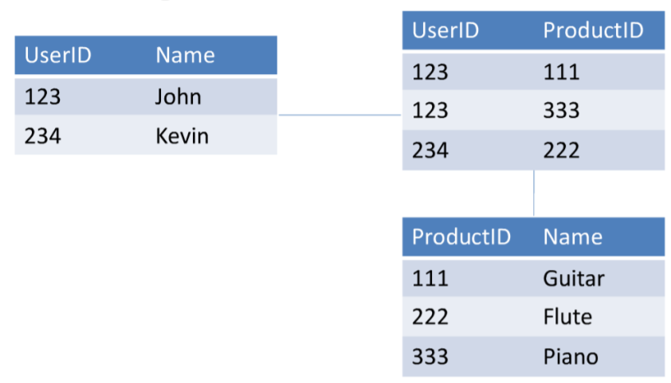
Denormalize design
Take the many to many relationship between customer and products :’Bought’
ER diagram in relational model :

Slide 44
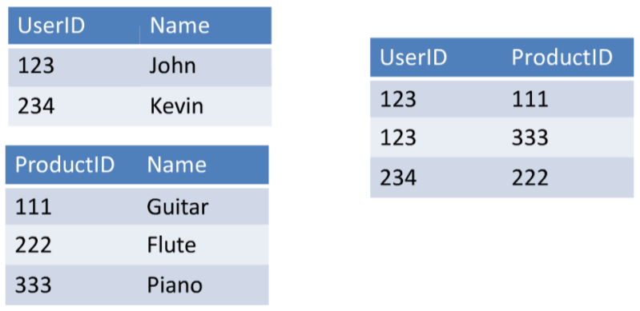
Normalize Structure
Cassandra has NO JOINS.
Normal form leads to poor performance as you have to look up both UserID and ProductID for each row

Slide 45
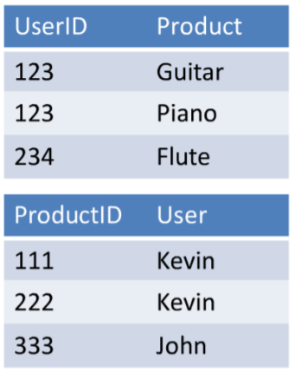
Denormalized
Two denormalized tables , each designed for specific query
I know the UserID, and wants all
the products they bought.
I know the PrdoductID and want
to know who bought it.

Slide 46
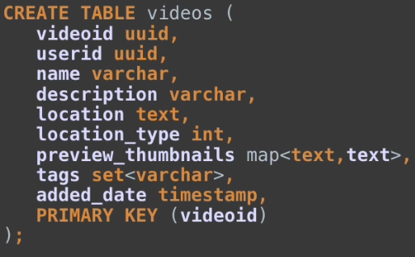
Table example
Table Name
Column Name
Column CQL Type
Primary key designation
Partition Key

Slide 47
Insert
Table Name
Fields
Partition Key : Required
Values

Slide 48


Partition Keys

Slide 49

Select statement
Primary Key : Partition key required

Slide 50
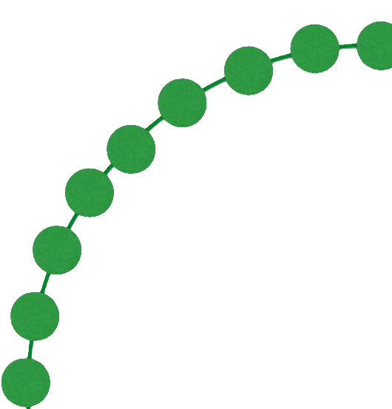
Locality
Notes:
Why is the partition key required ?
Each one of these has a token ring and we don’t have to scan 1000 node cluster

Slide 51
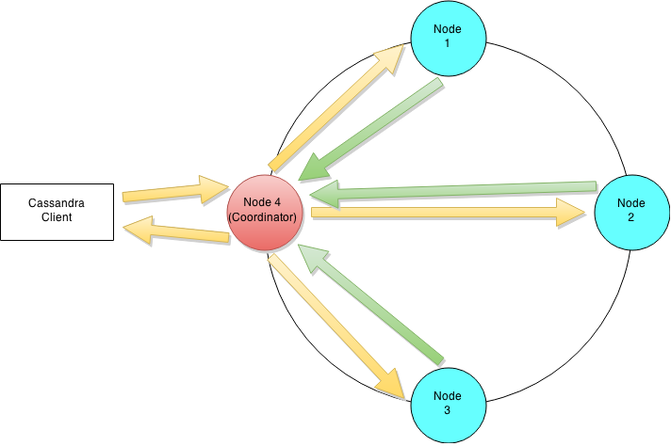
Cassandra Write Path

Slide 52
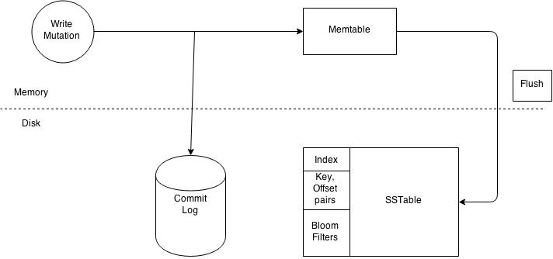
Write operation at node level

Slide 53
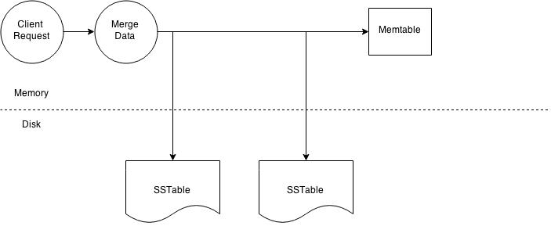
Node level read operation
Notes:
SSTable - A Sorted String Table (SSTable) ordered immutable key value map. It is basically an efficient way of storing large sorted data segments in a file.
Memtable - A memtable is a write back cache residing in memory which has not been flushed to disk yet.

Slide 54
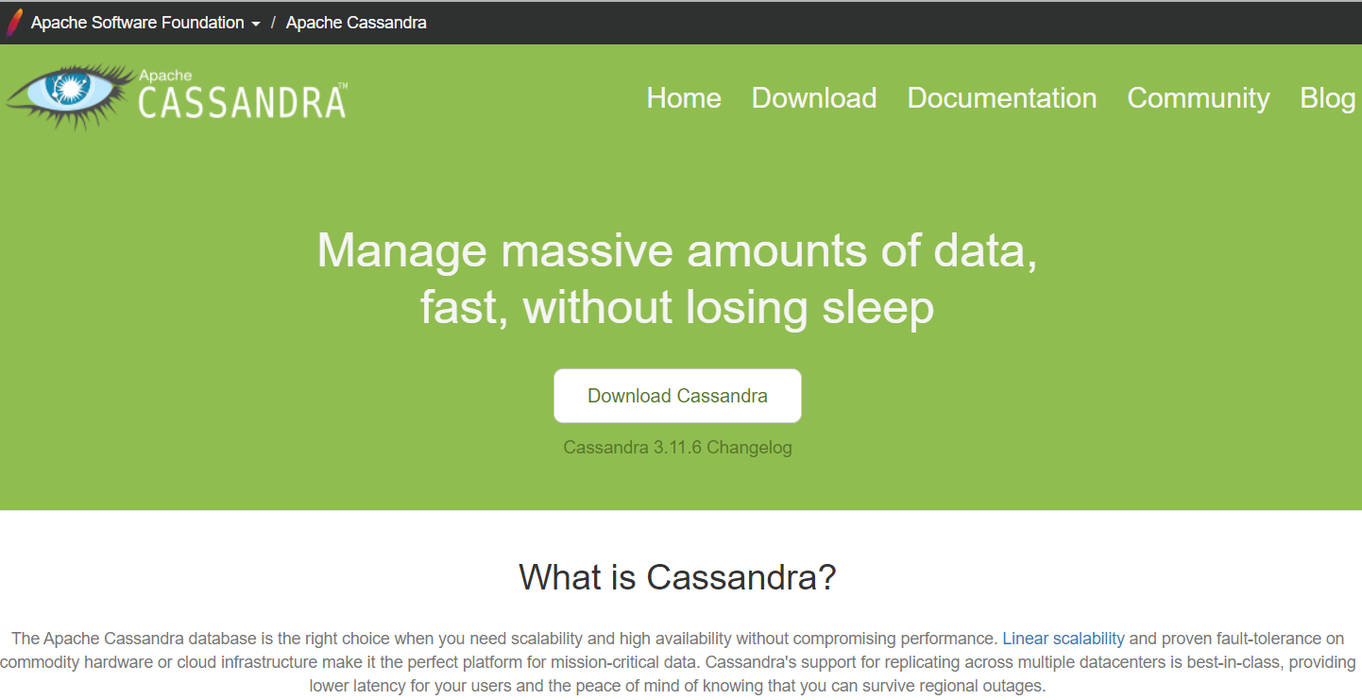
Cassandra Installation
Go to https://cassandra.apache.org/

Slide 55
Query Language - CQL
CQL ( Cassandra Query Language)
VERY SQL like syntax

Slide 56
Create keyspace
Strategy: While declaring strategy name in Cassandra. There are two kinds of strategies declared in Cassandra Syntax.
Simple Strategy: Simple strategy is used when you have just one data center. In this strategy, the first replica is
placed on the node selected by the partitioner. Remaining nodes are placed in the clockwise
direction in the ring without considering rack or node location.
2. Network Topology Strategy: Network topology strategy is used when you have more than one data centers. In this
strategy, you have to provide replication factor for each data center separately. Network topology strategy
places replicas in nodes in the clockwise direction in the same data center. This strategy attempts to place
replicas in different racks.
Replication Factor:
Replication factor is the number of replicas of data placed on different nodes. For no failure,
3 is good replication factor. More than two replication factor ensures no single point of failure.
Sometimes, the server can be down, or network problem can occur, then other replicas provide
service with no failure.

Slide 57
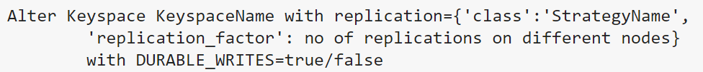
Alter keyspace

Slide 58

Drop/Delete keyspace

Slide 59
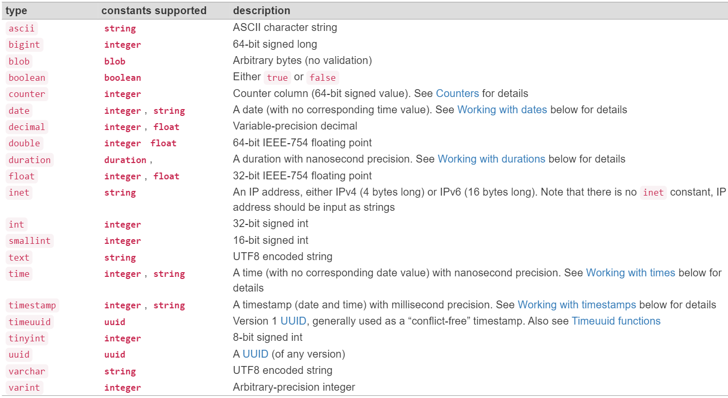
Datatypes in Cassandra

Slide 60
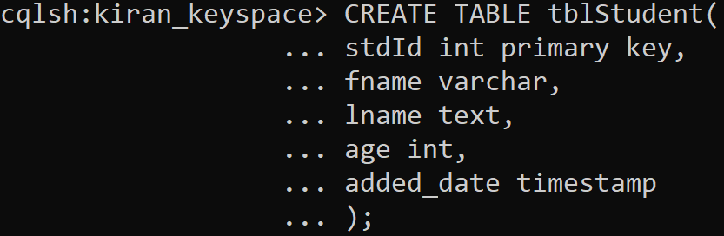
Create Table : tblStudent

Slide 61
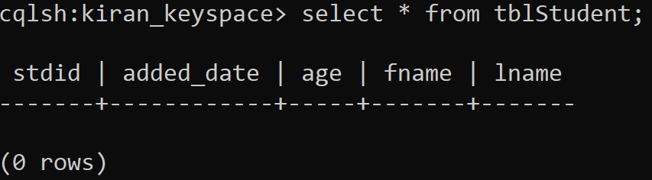
Select statement

Slide 62
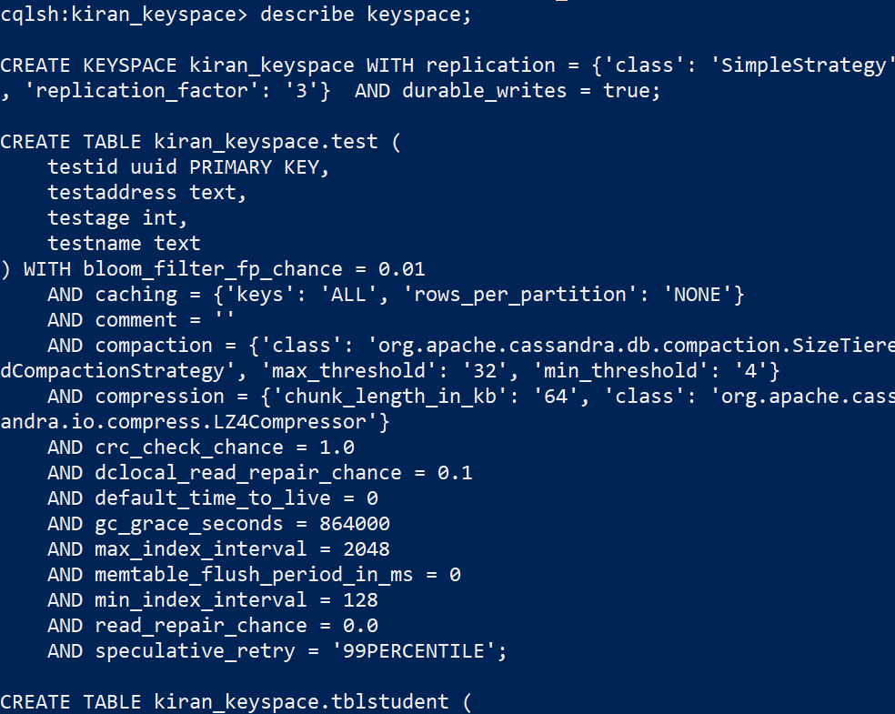
Describe Keyspace
Display all the details about current keyspace
- describe keyspace;

Slide 63
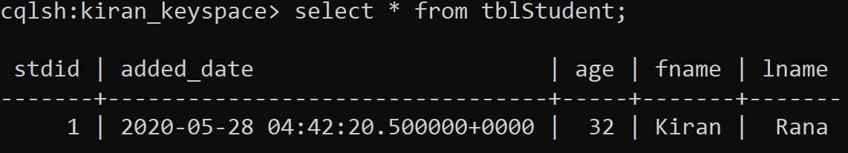
Insert data

Slide 64
Insert these data
id | fname | lname | age | date_added
1 | Kiran | Rana | 32 | Dateof(now())
2 | Salman | Khan | 55 | Dateof(now())
3 | Katrina | Kaif | 35 | Dateof(now())

Slide 65

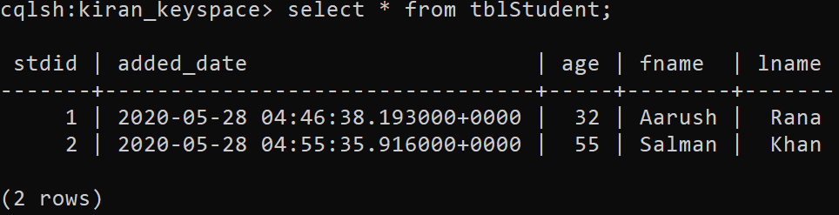
Update “Kiran” to “Aarush”

Slide 66
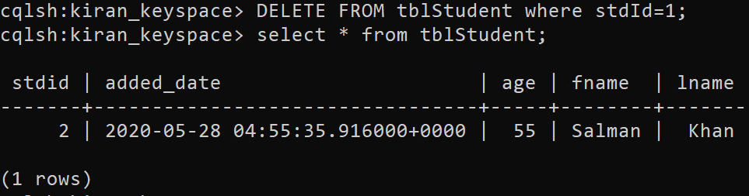
Delete

Slide 67
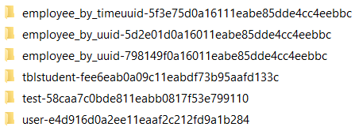

Drop Table
Drop table <<tablename>>
e.g drop table test
Goto Data->bin folder
Snapshot folder

Slide 68
Collections
CQL supports 3 kind of collections:
Maps
Sets
Lists
Notes:
Maps : Use a map when pairs of related elements must be stored as a key-value pair.
Sets : Using the set data type, store unordered multiple items.
Lists : Use a list when the order of elements matter or when you need to store same value multiple times.

Slide 69
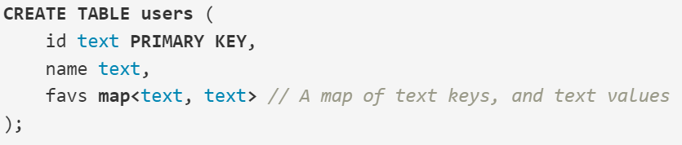
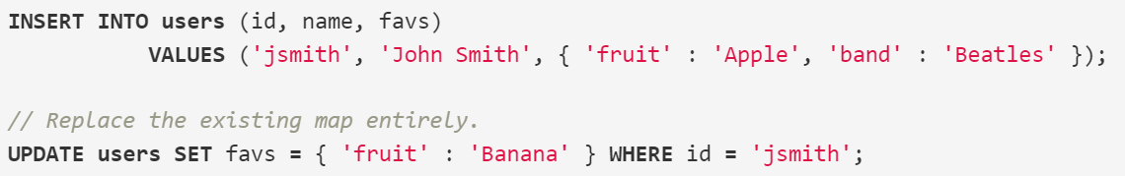
1. Maps
A Map is a (sorted) set of key-value pairs, where keys are unique and the map is sorted by its keys.

Slide 70
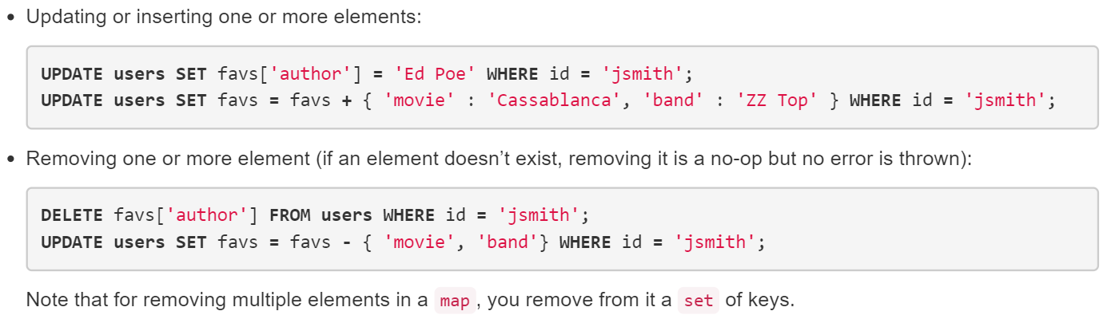
Update and Delete in Map

Slide 71
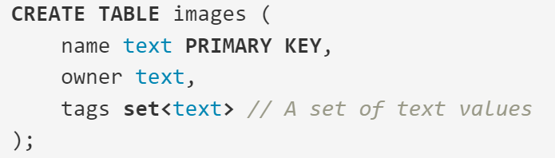
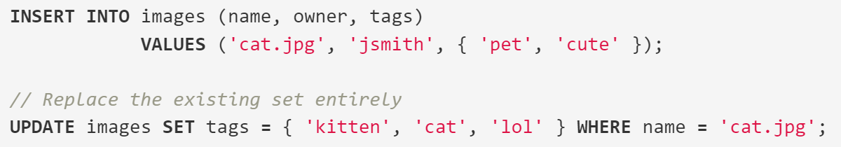
2. Sets

Slide 72
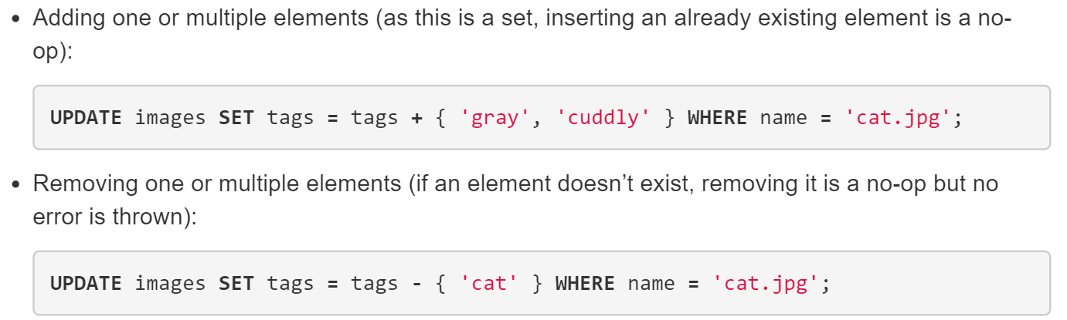
Update and Delete

Slide 73
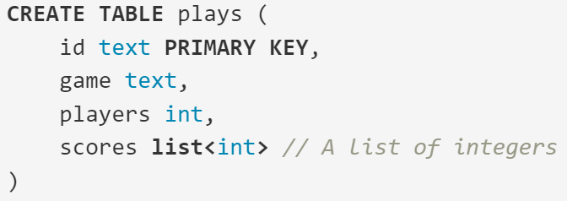
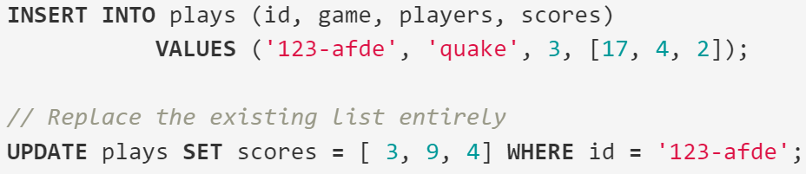
Lists
A list is a (sorted) collection of non-unique values where elements are ordered by there position in the list.

Slide 74
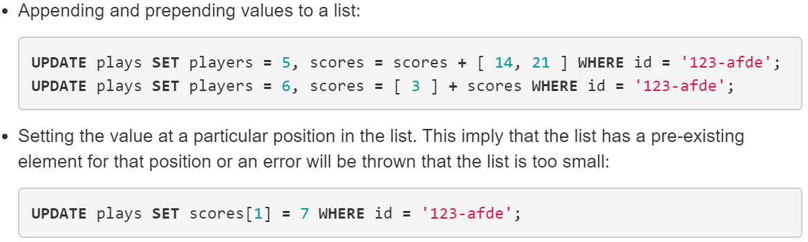
Updating List

Slide 75
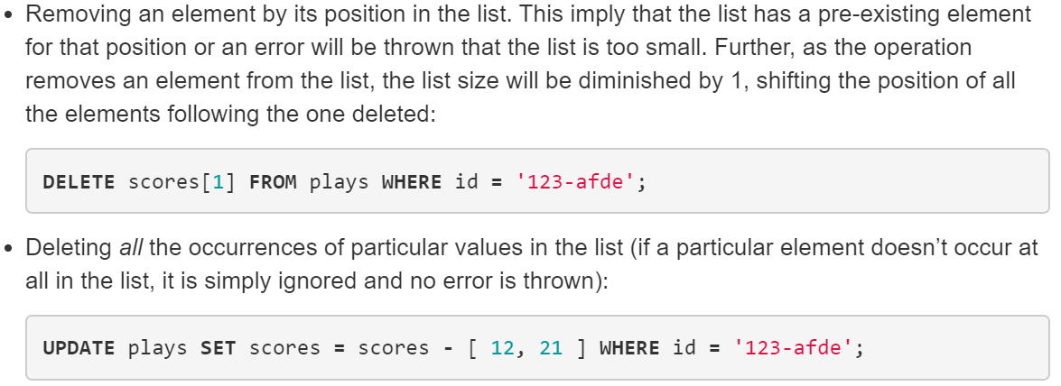
Deleting List

Slide 76
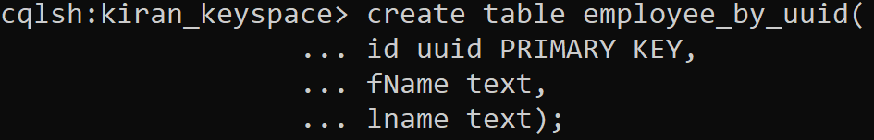
UUID (Universally unique identifier)
A Universally unique identifier is a 128-bit number used to identify information in computer systems.
It takes no parameter and generates a random Type-4 UUID suitable for use in Insert and Update statements;
Notes:
Version 4 (random)

Slide 77
UUID Versions
Version 1 (date-time and MAC address)
Version 2 (date-time and MAC address, DCE security version)
Versions 3 and 5 (namespace name-based)
Version 4 (random)

Slide 78
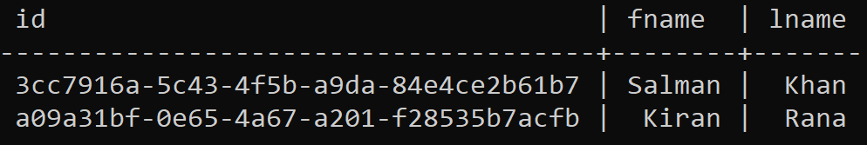
Inserting data

Slide 79
Timeuuid
Timeuuid types can be entered as integers for CQL input. A value of the timeuuid type is a Type 1 UUID.
A Version 1 UUID includes the time of its generation and are sorted by timestamp, making them ideal for use in applications requiring conflict-free timestamps.
For example, you can use this type to identify a column (such as a blog entry) by its timestamp and allow multiple clients to write to the same partition key simultaneously.
Collisions that would potentially overwrite data that was not intended to be overwritten cannot occur.

Slide 80
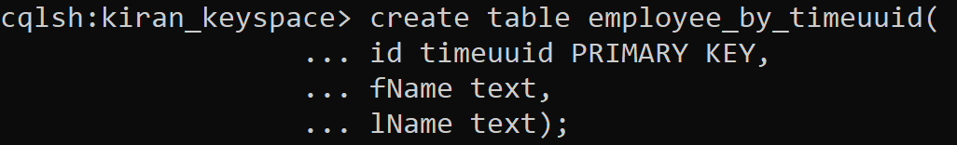
Create table with timeuuid

Slide 81
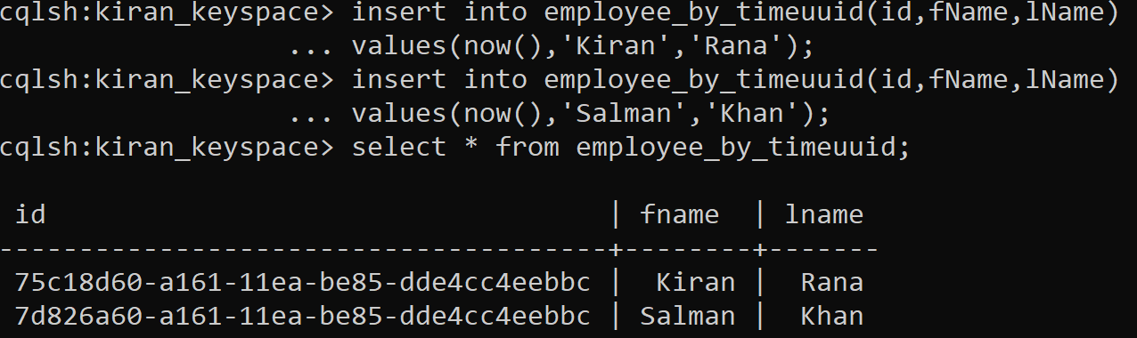
Inserting data

